Slide 1
Disruptive Innovation and the Future of Large Law Firms
An Overview of the Problems, Models, and Innovations
Business, Law & Innovation
April 21, 2009
Notes:
1

Slide 2
The legal industry seems to be “the last vestige of the medieval guild system to survive into the 21st century.”¹
“But new technologies, methods of production and innovations had served to displace most of the associated craftsmen. I reflected upon the legal world and the possible impact of information technology. And I wondered whether lawyers might fade from society as other craftsmen have done over the centuries.”²
¹ Source: “State of Technology in the Law”, March Chandler, January 2007
² Source: Richard Susskind, The End of Lawyers?: Rethinking the Nature of Legal Service, (2009)

Slide 3
Our Presentation:
Overview of the Problems
The Big Firm Model
The Demand Side Model
The Supply Side Model
Disruptive Innovations
Questions

Slide 4
Overview of the Problems

Slide 5
Many of the costs associated with big law firms are increasing …
Costs are Rising
First Years
Training
Institutional Incentives
Failure to embrace technology
ROI all too often zero or negative—associates leave¹
Firms lose 80% of law school hires within five years²
Rainmakers in price insensitive markets perceive themselves to be paying for partners who aren’t pulling their weight³
As recently as 2000, 83% of firms had no capacity to deal with electronic discovery⁴
¹ Source: http://papers.ssrn.com/sol3/papers.cfm?abstract_id=1121238
² Source: http://www.law.com/jsp/article.jsp?id=1202423430490
³ Source: http://papers.ssrn.com/sol3/papers.cfm?abstract_id=1121238
⁴ Source: http://www.senseient.com/publications/articles/article23.asp

Slide 6
At the same time revenues throughout the industry are hurting…
Per partner profits, lockstep pay, established clientele determine firm reputation
Top-school credentials overvalued relative to productive capacity
Resistance to demands of business
Revenues are Sinking
Limited measures of success
Gradualist response to customer demands
Notes:
At a famous presentation at Black and Decker, a consultant held up one of these, a drill, and asked the Black and Decker executives if this is what they sold. They all recognized the product and answered "yes". He then suggested to them, that from the customer’s point of view, what they are selling is this, a hole in a board.

Slide 7
The combination of increasing costs and decreasing revenues is creating a downward cycle …
Downward Cycle
More cyclical revenue stream
Intellectual Snobbery
Upticks in counter-cyclical work not compensating for decline in pro-cyclical work¹
Differential worse than 2001 recession¹
Refusing competitive bidding²
¹ Source: http://www.lawmarketing.com/pages/articles.asp?Action=Article&ArticleCategoryID=58&ArticleID=850
² Source: http://www.foley.com/news/news_detail.aspx?newsid=864

Slide 8
Things are going down the tubes

Slide 9
Big Firm Model

Slide 10
The big firm model is the base from which all the other models are built
Demand Model
Disruptive
Innovations
Big Firm Model
Supply Model

Slide 11
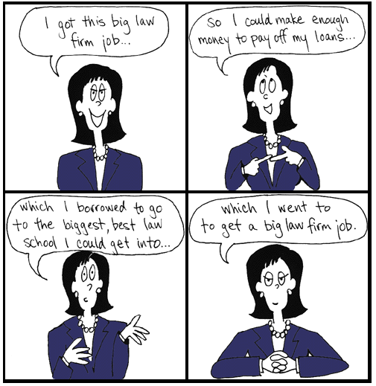
Big law firms hire the best students from the best schools and pay them the best money, the firm prospers on its scale and brand¹
A Big Law Firm is an “all-in-one” service provider to its client. It gains more revenue by relying on its brand to cross-sell and survives in down markets by having scale large enough to accommodate up and down market legal services.
Distinguishing Features
2
Scale: over 100 lawyers and can have upwards of 1000 lawyers
“All-in-one” Services: provides many services and practice areas to its clients
Legal Brain Surgery: hires the best people and willing to take on the most challenging problems
Highest fees, highest profits per attorney and profits per partner
¹ Source: Marc S. Galanter & William D. Henderson, The Elastic Tournament: The Second Transformation of the Big Law Firm, STANFORD LAW REVIEW, Vol. 60, April 2008
² Source: http://www.lawtoons.com/

Slide 12
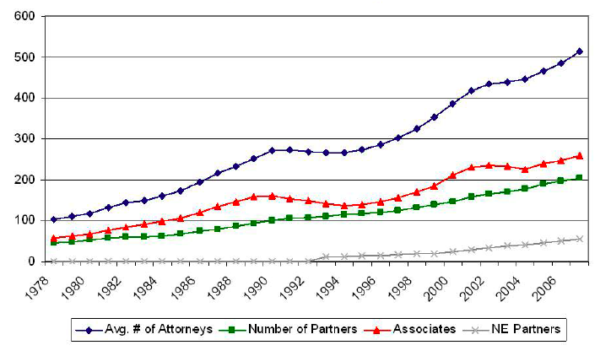
Big law firms are the “fastest-growing, most prosperous, and most dynamic sector of the profession”¹
By the Numbers¹
Only 1% of law firms have 100+ lawyers
As of 2000 14% of lawyers in private practice worked at firms with 100+ lawyers²
Big law firms were estimated to hire ten thousand new associates in Fall 2008³
Growth of Large Law Firms¹
¹ Source: Marc S. Galanter & William D. Henderson, The Elastic Tournament: The Second Transformation of the Big Law Firm, STANFORD LAW REVIEW, Vol. 60, April 2008
² Source: Clara N. Clarkson, THE LAWYER STATISTICAL REPORT: THE U.S. LEGAL PROFESSION IN 2000 , (2004).
³ Source: Aric Press, The New Reality, Am. Law., Aug. 2007, at 91.

Slide 13
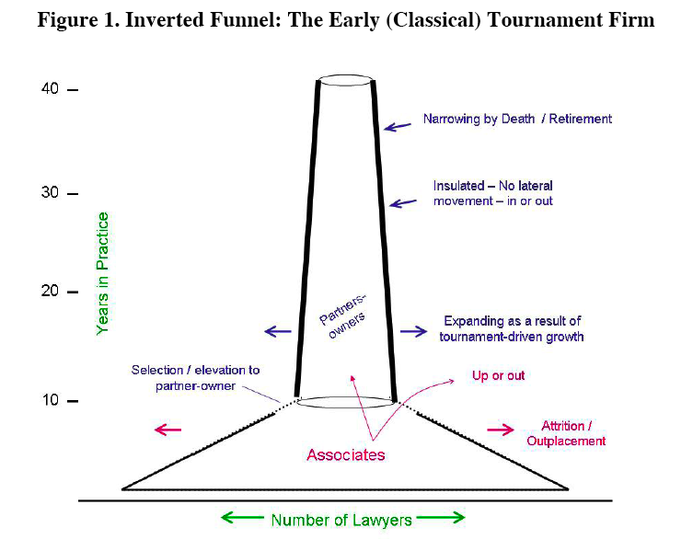
The old big firm model …
Source: Marc S. Galanter & William D. Henderson, The Elastic Tournament: The Second Transformation of the Big Law Firm, STANFORD LAW REVIEW, Vol. 60, April 2008

Slide 14
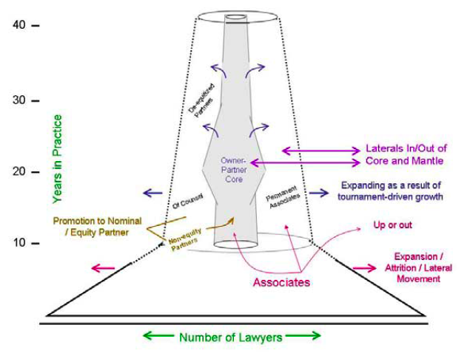
The new big firm model …
Source: Marc S. Galanter & William D. Henderson, The Elastic Tournament: The Second Transformation of the Big Law Firm, STANFORD LAW REVIEW, Vol. 60, April 2008

Slide 15
In order to stay competitive the big firm model needs to change: the old “up or out” model needs to change
“Old” Big Firm Model
“New” Big Firm Model
Partnership or exit
Gruelling workload
Challenging assignments
Basis of brand: the Firm
Alternatives to “up or out”:
Permanent associates
Of counsel
De-equitized partners
Workloads based on path
Basis of brand: the attorney
Outsource routine tasks

Slide 16
Demand Model

Slide 17
A boutique law firm is a collection of attorneys specializing in a niche area of law practice¹
A Boutique Firm Model keeps the basic business model of the Big Firm Model, specifically the same costs, but is successful because it increasing revenues by focusing on highly profitable practice areas
Distinguishing Features
One, or a select few, practice areas
Generally “mid-sized”, less than 100 lawyers (notable exceptions exists)
More attention to and focus on clients’ needs
“Lower fees”
“Niche” Areas
Mergers and Acquisitions
Intellectual Property
Litigation
Bankruptcy
And others …
¹ Source: http://en.wikipedia.org/wiki/Boutique_law_firm

Slide 18
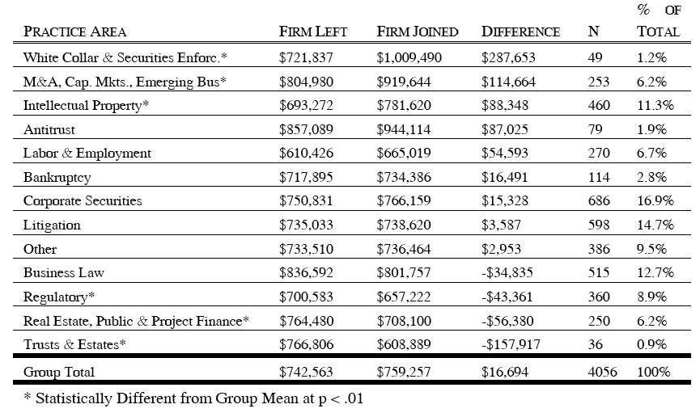
The most profitable practice areas make the best niche areas for boutique firms
Mean Profits per Partner of Lawyer Partners, by Practice Specialty, 2000-05
Source: Forrester Research.
Source: Marc S. Galanter & William D. Henderson, The Elastic Tournament: The Second Transformation of the Big Law Firm, STANFORD LAW REVIEW, Vol. 60, April 2008

Slide 19
What’s the difference between a big law firm and a boutique?¹
Boils down to the difference between driving a Lincoln Town Car and a Ferrari:
"When you're in the Lincoln Town Car [a big law firm] and you go over a bump in the road, you don't really feel it that much. In turn, boutiques are the Ferrari. When you hit a bump, you really feel it. But you can also turn on a dime, which you can't do in the Town Car.”
vs
¹ Source: Karen Sloan, “Boutique Firms Well-Positioned in Current Economy” THE NATIONAL LAW JOURNAL; December 3, 2008

Slide 20
Why the boutique model is innovative: “boutiques fill niches”¹
What Boutiques Do Well
Rely on referrals²
Focus on their core strengths and expertise
Give clients more time and attention: especially smaller clients
Respond quickly to economic changes (sometimes)
"One of the great benefits of a general practice firm is that you are hedging your bets. If you are a boutique, to some degree you are putting all your eggs in one basket."
¹ Source: Katie Weeks, “Boutique law firms thrive in entrepreneurial climate: attorneys who go solo discover fringe benefits for themselves, clients;”
SAN DIEGO BUSINESS JOURNAL, August 7, 2006.
² Source: Alfred L. Scalan, Jr. & Marc Seldin Rosen “Boutiqu e Practice” The Compleat Lawyer, Vol. 13, No. 4, Fall 1996.
³ Source: Karen Sloan, “Boutique Firms Well-Positioned in Current Economy” THE NATIONAL LAW JOURNAL; December 3, 2008

Slide 21
Why the boutique model is not innovative enough…
Not very Innovative
Same cost structure
Over-reliance on “star” partners
Expansion blurs the line between boutiques and big law
Examples of Failure
Pennie & Edmonds
Fish & Neave
It is Hard to be Small
Lack the leverage and durability of their larger rivals
When times get tough many firms merge or dissolve
Parker Chapin Flattau &
Klimpl, LLP
Cronin & Vris
Walter, Conston, Alexander
& Green, P.C.
¹ Source: http://en.wikipedia.org/wiki/Boutique_law_firm

Slide 22
Supply Model

Slide 23
Axiom and other similar firms provide high-end temp services to leading blue-chip clients¹
These firms keep the basics of the Big Firm Model, specifically the same revenue model, but are successful because they decrease costs by sending lawyers to the client and eliminating a traditional partnership model.
Distinguishing Features
No offices: Lawyers work at the client’s office
Lawyers work on assignment on a temporary basis
Lower fees: Clients are charged less than traditional large firms charge
No partnership track: hire only laterals and pay them $100-200K
Examples
¹ Source: “Finding Happiness on the Slow(er) Track”, Wall Street Journal, December 05, 2006

Slide 24
What people are saying…
While many companies lack the budget to employ full-time general counsel, their legal service needs can be significant. Many such companies in Austin are turning to firms specializing in outsourced general counsel services.¹
"The market is pretty ready for this. It's nice to be involved with a new, young dynamic company [like Axiom] that's trying to be something different in an area that's been so traditional and stuck in its ways.” ² (current associate)
"If that's what a student has decided he or she wants, I think it's completely fine," says Larry Kramer, the dean of Stanford Law School. But "if this is your ambition, you might think twice about coming to a school as challenging, difficult and expensive as Stanford.”³
¹ Source :Tonyia Sullivan , “Small businesses save money by hiring outsourced counsel,” AUSTIN BUSINESS JOURNAL, February 10, 2006
² Source: Alison Maitland, “Take the law into your own hands” FINANCIAL TIMES, November 27, 2007
³ Source: “Finding Happiness on the Slow(er) Track”, Wall Street Journal, December 05, 2006

Slide 25
Why the supply model is innovative …
Drastically Reduce Costs¹
Focus on Smaller Companies
Minimal real estate overhead
No money supporting "partnership pyramid”²
Minimal support staff
Pass off costs to clients
Only pay attorneys for the work they do: pay by the hour
Personalized service
Flexibility to client demands
Length of projects based on what clients need: short-term or indefinite
Willing to work on alternative billing structures
¹ Source: Michael Law, Law Firm 2.0: The New Business Model of the Legal Industry, July 9, 2008: http://lawvibe.com/law-firm-20-the-new-business-model-of-the-legal-industry/
² Source: “Litigating for Less”, FAST COMPANY, December 9, 2003

Slide 26
Why the supply model is not innovative enough …
Workers are Temps¹
Limitations on Work
Only the best: 1 out of 100 applicants, all laterals from best school and best firms
No employee hierarchy: where will you be in five years?²
No guaranteed income while “on the beach”
Will not do “legal brain surgery”
Bet-the-company litigation
Major mergers
A good in-house general counsel does the same work
High Turnover: generally to join companies that had hired them on a temporary basis³
“That's the thing about Axiom: There's no defined goal at the end of it.” So, when Mr. Lee [current associate] eyeballs his professional future in law, say, five years down the road, what does he see? "I really don't know," he says.”²
¹ Source: Alfred L. Scalan, Jr. & Marc Seldin Rosen “Boutiqu e Practice” The Compleat Lawyer, Vol. 13, No. 4, Fall 1996.
² Source: “Finding Happiness on the Slow(er) Track”, Wall Street Journal, December 05, 2006
³ Source: Eric Young, “Lawyers just as needed: Market grows for temporary legal fire power” SAN FRANCISCO BUSINESS TIMES, September 15, 2006.

Slide 27
Disruptive Innovation

Slide 28
Truly innovative law firm do three things differently: revolutionize costs, reconfigure personnel, and reprioritize custom satisfaction¹
Basic Change
Disruptive Innovation
Revolutionize Costs
“Cut the Fat”: Reduce all unnecessary internal costs
Change the billing structure
Reconfigure
Personnel
With people
With technology
Reprioritize
Customer Satisfaction
Firm focuses on specific client’s needs
Allow clients to dictate their needs to the firm
¹ Source: “State of Technology in the Law”, March Chandler, January 2007

Slide 29
There are at least three alternatives to the current model of the billable hour …
Current Model:
The Billable Hour
Contingent
Fees
Alternative
Models
Fixed
Fees
Retrospective
Bonuses

Slide 30
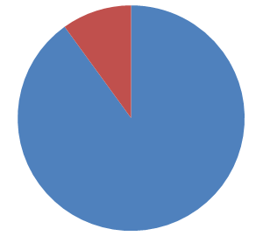
Moving away from the billable hour fundamentally alters the entire business model
The billable hour: “It’s like a pie eating contest where the prize is more pie”¹
Only 10% of Corporate Counsel Use Alternative
Fee Structures More than Half the Time²
Partnership Inhibits Transition
Reverses Existing Incentives
Perception of zero-sum game
Partnership is disinclined to discuss how to re-divide a shrinking pie
Cut costs to the bone—directly tied to profit
More realistic conversation about client’s needs and expectations
¹ Source: http://www.lawcrossing.com/article/627/Creative-Billing:-Is-the-Reign-of-the-Almighty-Billable-Hour-Over?/
² Source: http://adverselling.typepad.com/how_law_firms_sell/2009/03/alternative-fees-part-10-today-and-tomorrow.html

Slide 31
Reconfigure personnel by allowing technology to replace part of the work currently done by attorneys
Automated Intake Interviews
No Loss to the firm: Specific, hard questions will be asked later
Processing competencies required for coming revolution in marketing model: 30 minutes of fast-talk won’t seal the deal

Slide 32
Standardize certain tasks so the grunt work can be done by the business with lawyers supervising
Document Assembly¹
Standardized legal rhetoric from courts allows consistency
Bargaining chips explained and understood by business
Negotiation no longer occupied by legal middlemen
¹ Source: http://business.timesonline.co.uk/tol/business/law/article2931356.ece

Slide 33
Firms must leverage technology to change expectations and personalize service to their clients
Personalized Updates
Basic Change
Disruptive Innovation
Revolutionize Costs
Updates to products / premises liability filtered by firm
West Keys or Search Advisors for consumers
Benefits:
Streamlined¹
Commoditized²
Different level of competition
¹ Source. http://www.law.duke.edu/journals/dltr/articles/2003dltr0004.html
² Source: http://business.timesonline.co.uk/tol/business/law/article2931356.ece

Slide 34
Allowing clients to dictate their needs involves trusting your clients to evaluate the work you do
Current Failure
Martindale-Hubbell and Peer Reviews:
“Lawyers rating lawyers for the benefit of lawyers seeking to hire lawyers.”
Solution
Online Quality Surveys
Disrupt established loyalties for superior service¹
Undermine existing information inequalities²
Symbols of quality lose value (brand, pay, price point)
¹ Source: http://www.law.com/jsp/legaltechnology/pubArticleLT.jsp?id=1204287434436
² Source: http://www.hubbardone.com/company/pressdetail/?news=178

Slide 35
Legal Auction and Networking Sites are two tools firms will use in the future to allow clients to dictate their needs
What is the problem?
Two Models:
Auction-Style Legal Services Sites
Social Networking Style Legal Services Sites
One Purpose:
Undermine imperfect information to put the clients back in control
Accentuating the Negative
Changing the Game
Indirect attack on reverse incentives dilemma
Loyalty attached to lawyer, less attached to brand
Customer-driven reform integrated into service model²
Solo practitioners can always get work; undermining scale³
¹ Source: http://www.law.com/jsp/law/careercenter/lawArticleCareerCenter.jsp?id=1202429558341
² Source: http://jurylaw.typepad.com/deliberations/social_networking.html
³ Source: http://www.law.com/jsp/legaltechnology/pubArticleLT.jsp?id=1190192571364

Slide 36
Questions?
A highly qualified team
Cedric Allen
Project Partner
Austen Heim
Project Partner
Cedric Allen has the greatest poker-face of all time. He won the 1983 World Series of Poker, despite holding only a Joker, a Get out of Jail Free Monopoly card, a 2 of clubs, 7 of spades and a green #4 card from the game UNO. He was born in 1985.
Austen Heim sold his soul to the devil for his rugged good looks and unparalleled martial arts ability. Shortly after the transaction was finalized, Austen roundhouse-kicked the devil in the face and took his soul back. The devil, who appreciates irony, couldn't stay mad and admitted he should have seen it coming. They now play poker every second Wednesday of the month.
Adam Dell
Faculty Advisor
Adam Dell is kind of a big deal, people know him. I mean the guy has a Wikipedia page. Which says he conceived and wrote the story for a documentary film. Rumor has it he can win at Connect Four in only three moves. Adam also invented Kentucky Fried Chicken's famous secret recipe. He has not slept more than four hours in a night since he was seven.

